Slide 1

REINFORCEMENT LEARNING THROUGH GAMIFICATION
(LEARNING HOW TO LEARN WITH AI AND VIDEOGAMES)
Luka Jovanovic

Slide 2
Gamification?
Gamification enhances user engagement by incorporating game-like elements, such as challenges, rewards, and competition, to make tasks more enjoyable and motivating.
It leverages psychological principles to influence behavior, tapping into intrinsic motivators like achievement, recognition, and a sense of accomplishment, driving participants to complete tasks or meet goals.
Gamification is an effective tool for education and training, providing an interactive and immersive environment that facilitates learning through simulation, problem-solving, and hands-on experiences.
Gamification platforms often collect valuable data on user interactions and performance. Analyzing this data provides insights into user behavior, preferences, and areas for improvement, enabling organizations to refine their strategies.

Slide 3
Why do we play games?
Games provide a source of fun and entertainment, offering an immersive and engaging experience that can be pleasurable and enjoyable.
Games often present challenges and goals, offering a sense of accomplishment when these challenges are overcome.
Games often require strategic thinking, problem-solving, and quick decision-making. Playing games can enhance cognitive abilities, improve reflexes, and develop various skills depending on the nature of the game.

Slide 4
Learning from games in a safe way
Games can create realistic scenarios that allow learners to practice and apply skills in a safe, controlled environment, minimizing real-world risks and consequences.
Games provide instant feedback on actions and decisions, allowing learners to learn from mistakes without real-world repercussions. This iterative process supports a safe and effective learning experience.
Games encourage active participation and hands-on learning, promoting a deeper understanding of concepts. The interactive nature of games enhances retention and application of knowledge.

Slide 5
Games as soft simulations
Games create immersive environments that simulate real-world situations, providing a platform for users to experience and navigate scenarios in a controlled, virtual setting.
Soft simulations in games provide a safe space for users to learn from failures and mistakes.
The consequences within the game environment don't carry over to reality, encouraging experimentation and learning through trial and error.

Slide 6
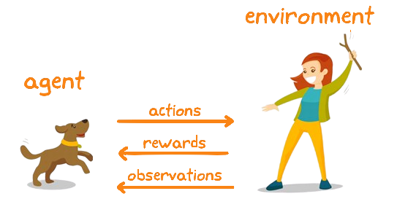
Reinforcement learning

Slide 7
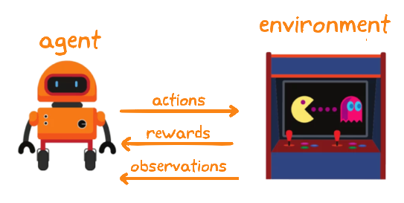
Reinforcement learning

Slide 8

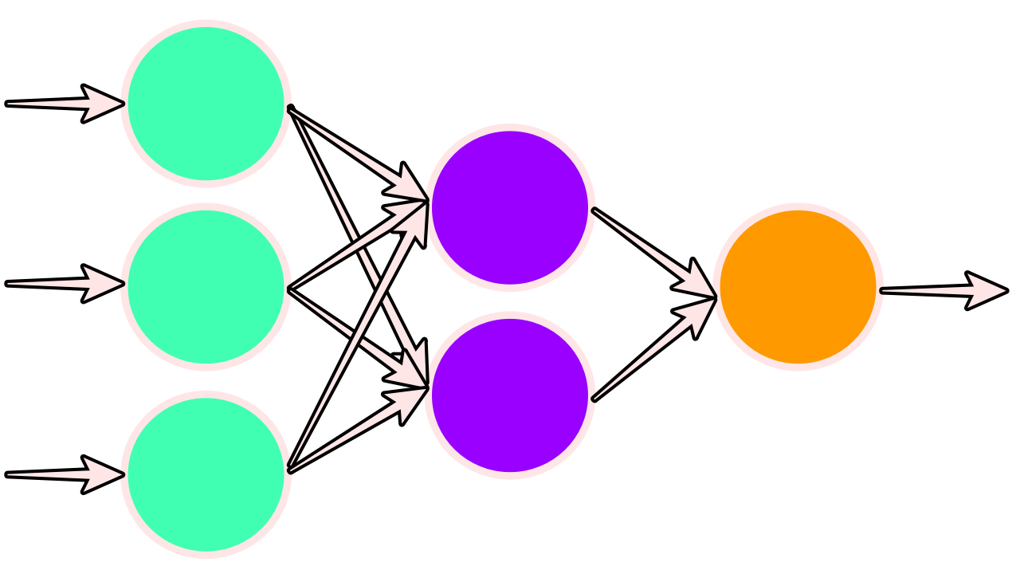
Artificial neural netowrks

Slide 9
Reinforcement learning

Slide 10
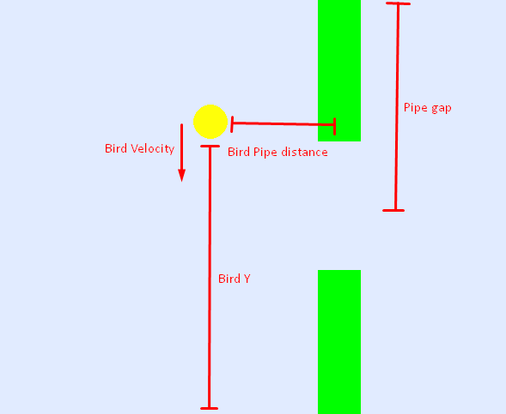
Environment

Slide 11

Population based approach
Generate a population of agents that interact with the environment
Reward well performing agents more
Simulate natural selection
Select towards a desired population behavior
Encode agent characteristics as genetic data

Slide 12
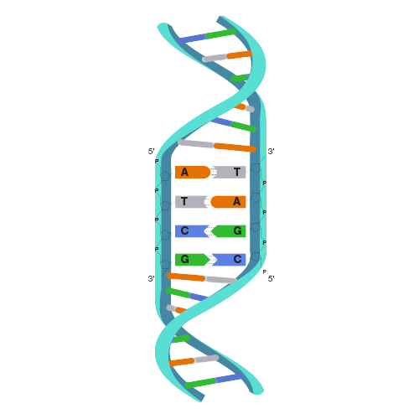

Genetic Encoding

Slide 13
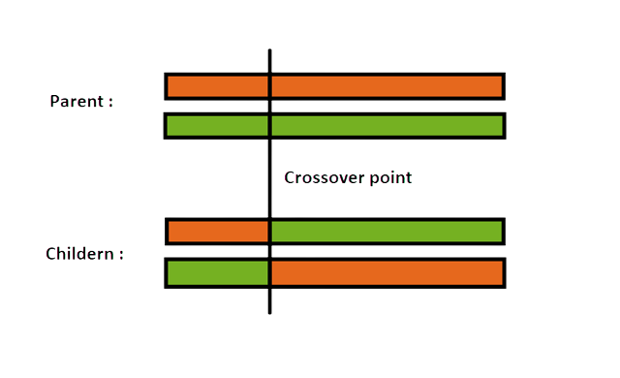
Genetic Crossover

Slide 14

Genetic Mutation

Slide 15
Rewarding
Selection: Choosing individuals from a population based on their fitness or suitability for solving a particular problem, mimicking the concept of natural selection
Crossover: Combining genetic material (genes or solutions) from two parent individuals to create new offspring, simulating genetic recombination and introducing diversity into the population.
Mutation: Introducing random changes or alterations to the genetic information of individuals, helping explore new solution spaces and preventing the algorithm from converging prematurely.
Fitness Evaluation: Assessing the performance of individuals in the population based on a predefined fitness function, guiding the algorithm toward solutions that are better adapted to the problem at hand.

Slide 16

Code
Theories are like parachutes – they work best when they're open and put into practice.
Let’s make it all work!

